Slide 1
Society of Women Engineers West Virginia University Mid-September General Meeting

Slide 2
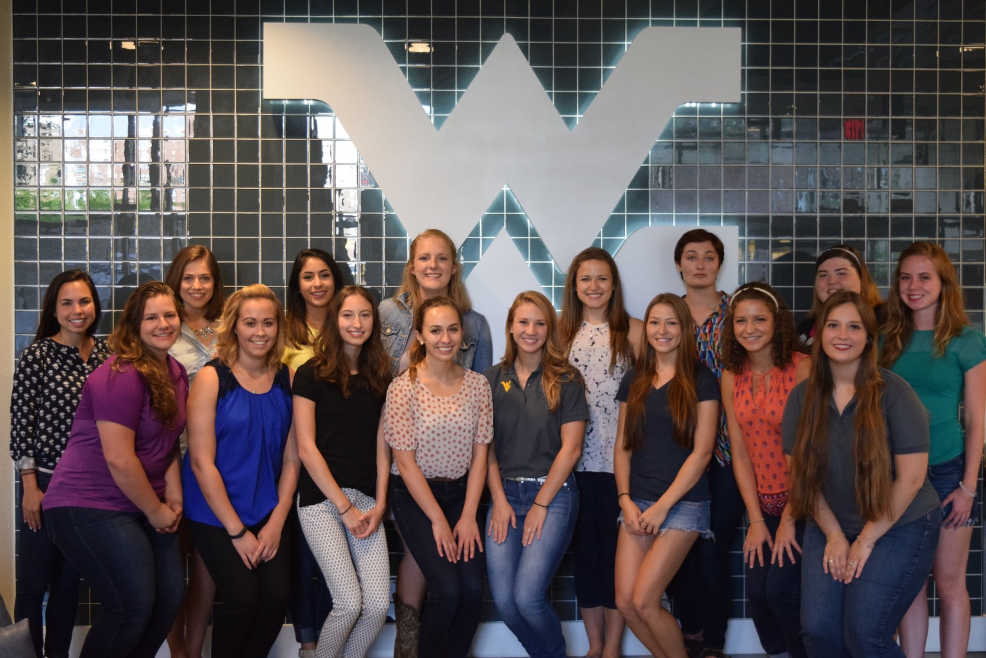
Agenda
Ice Breaker Bingo
Societal SWE
Murder Mystery Lunch
Conferences
SWE-sters Mentor Program
Upcoming Events
Additional Info
Stay for our OCE!

Slide 3
Ice Breaker Bingo!
Find people to sign your bingo board based on the spaces that correspond to them!

Slide 4
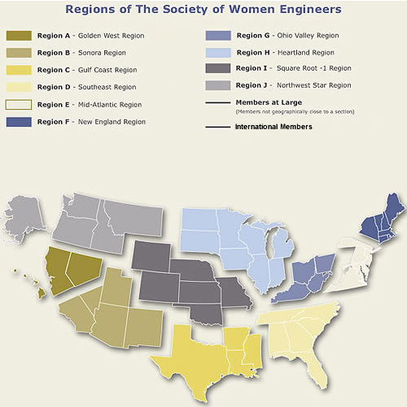
Societal SWE
SWE has Sections available for members, whether it be collegiate or professional, as well as being able to participate as a Member-at-Large or an International member
Members-at-Large(MAL) is a member of a region who is not a member of a section. There are areas in the US that are not assigned professional sections
Ali Anderson is our Region G MAL rep!
There are more than 300 collegiate and 100 professional sections
There are 10 regions that SWE sections fall under
We are located in Region G, the Ohio Valley Region (West Virginia, Western PA, Ohio, Kentucky)

Slide 5
Murder Mystery Lunch
THIS SATURDAY…We need volunteers!
Girls ages 7-9 have to figure out who committed a murder based on clues given to them after completing STEM related activities
10:00 AM – 1:45 PM
Theme: Zootopia
Need paper towel rolls and toilet paper rolls for activities
Sign up!
**Station training will be on Friday at 5pm outside of the ELC

Slide 6
WE16 Societal Conference
In Philadelphia, PA
October 27th-29th
Will be an excused academic absence
Leave on Wednesday, return on Sunday
**We have 4 open spots for those who are willing to pay for their portion of the room – we will provide transportation for free
~$300 when split four ways for 4 nights
Region G provides grants! Can provide more information once it is received
Come talk to us at the end of the meeting if interested

Slide 7
WE Local Conference
In Pittsburgh, PA
February 17th-19th
The WE Local Pittsburgh Host Committee is looking for additional volunteers
The Pittsburgh host committee is looking for additional volunteers (Specifically, volunteers interested in communication- primarily through social media, volunteer coordination, and outreach)
If you’re interested or want more information, please contact Rebecca Ciez at rciez@andrew.cmu.edu or check out welocal.swe.org
Great way to get involved with SWE on a larger scale and build your resume!

Slide 8
SWE-ester Mentoring Program
Over 40 girls already signed up!
Underclassmen paired with upperclassmen based on major and an interest form
Group events:
Mentor/Mentee Introduction event
Scavenger Hunt in the fall
Committee to plan another event for spring semester
*Last day to fill out form will be Wednesday, September 21st!

Slide 9
Social Events
Trunk or Treat
Friday, October 28th @ 5pm in the Coliseum parking lot (shell building if rain)
Coming soon…
Going to a haunted house!
Check email in the coming weeks for details!
Movie Night: Sully (landing the flight on the Hudson)
Tuesday, September 20th
$6 for tickets

Slide 10
Nursing Home Outreach Event
Where: During SWE meeting in ESB G83
Date: October 12th
Event: Making Halloween goodie bags
Donations needed!
Nail polish/nail art
Soft candies (3 musketeer, Reese’s, etc.)
Halloween-themed ribbon (to tie the baggies with)
Halloween goodie bag donations can be dropped off at Cate’s office by the ELC
“Yard Sale” Donations
Old purses
Craft kits
Bracelets
New/gently used blankets
Fuzzy socks/slippers
Coloring books
Yard Sale donations can be brought to the next meeting or you can meet with Denna: ddavari@mix.wvu.edu

Slide 11
Upcoming Community Service Events
Saturday, October 8- STEM Day at Morgantown Public Library (9-2p.m.)
Tuesday, October 11- Girl Powered Robotics Expo at Westwood Middle School; SWE guest speaker and potential mentoring program with robotics team (6-8 p.m.)
Wednesday, October 12- Cheat Lake Elementary School Science Fair; Judges and STEM table volunteers needed (6-8 p.m.)
Thursday, October 20- Lights on After School at Preston County High School (5-7 p.m.)
Friday, October 28- Pumpkin Drop (7a.m.-5 p.m.); volunteers needed for set up, vending, STEM zone, directing, cooking, clean up in drop zone, tear down

Slide 12
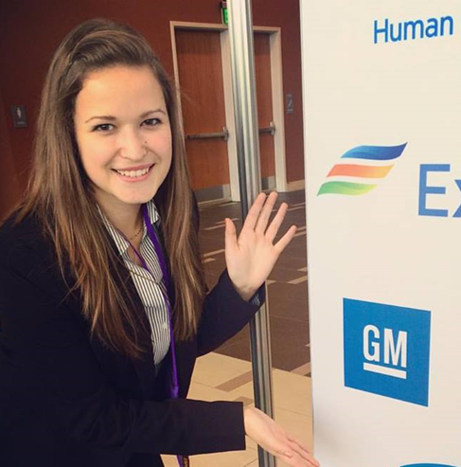
Professional Development
Resume Collection
Still collecting resumes! Get yours in before the career fair next week!
Email to wvuswe@gmail.com with specified info (in past email, ask if you need it)
2016 Internship/Co-Op Feature
Did you have an exciting summer as an intern/co-op? We want to know! Fill out this survey and email us a photo of you on the job so that we can share on our social media websites!
Survey: https://goo.gl/forms/Rvbmb8o4ejkL8kgS2

Slide 13
Join Societal SWE!
Though you are more than welcome to join WVU SWE and attend our events…
IF YOU ARE NOT A PAID MEMBER, YOU ARE NOT A SWE MEMBER, AND YOU CANNOT PUT IT ON YOUR RESUME!
If you need financial assistance, let us know!
http://societyofwomenengineers.swe.org/index.php/membership
Follow us to register if you want to join!

Slide 14
Contact Information
E-mail:
wvuswe@gmail.com
Facebook:
www.facebook.com/WVU_SWE
Twitter:
@WVU_SWE
Website:
http://swe.orgs.wvu.edu/
LinkedIn:
WVU SWE
Region Blog:
http://region.wordpress.com/

Slide 15
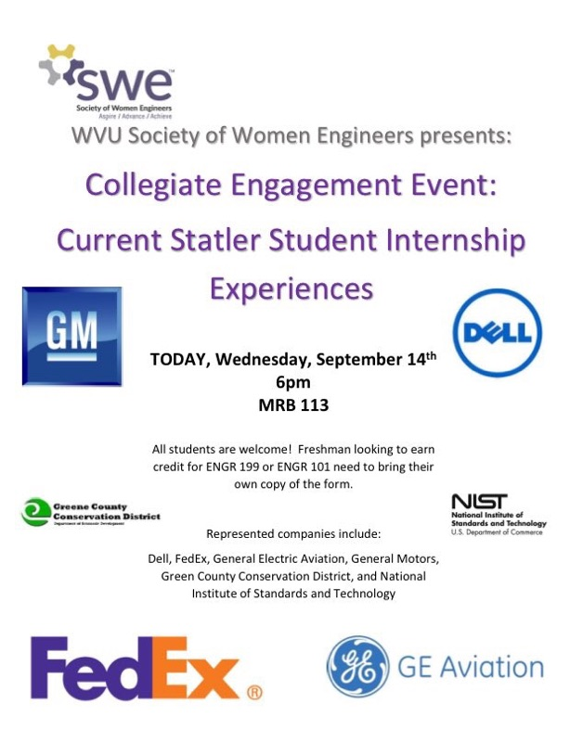
Stay here for our OCE! *Grab an OCE form from ELC

