Slide 1
Society of Women Engineers West Virginia University Section 1st General Meeting
Tuesday, September 8th, 2015

Slide 2
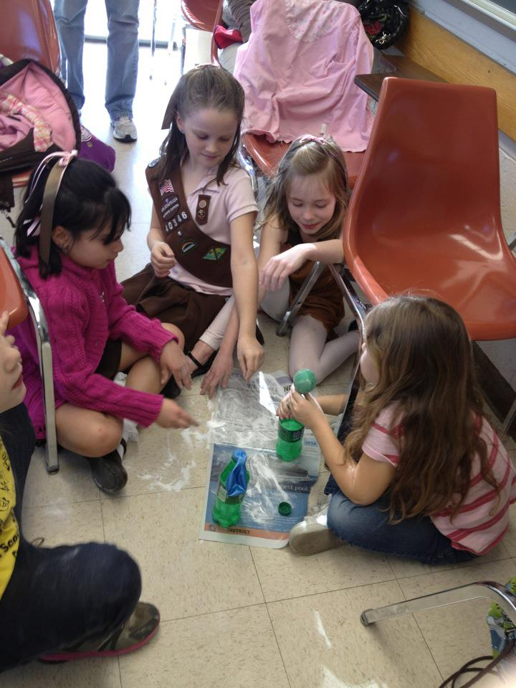
Agenda
What is SWE?
Officer Introductions
Events
Murder Mystery Lunch
Intramural Softball
Professional Development
Membership
Contact Information

Slide 3
What is SWE?
Mission
Stimulate women to achieve full potential in careers as engineers and leaders, expand the image of the engineering profession as a positive force in improving the quality of life, and demonstrate the value of diversity.
*Following SWE events, girls report that they are twice as likely to have an interest in becoming an engineer.

Slide 4
Officer Introductions
Officers
President | Becca Cokeley
Vice President | Julie Peng
Secretary (Fall) | Grace Slusser
Secretary (Spring) | Taylor Davis
Treasurer | Haley Morella
Awards and Grants Chair | Madison Thompson
Social Events Chair | Sabrina Ridenour
Corporate Relations | Lauren Moore
Webmaster | Eilish Miller
Historian | Meg Neely
Event Leads
Murder Mystery Lunch | Megan Porter
Trunk or Treat | Alex Anderson
Trunk or Treat | Anna Gilpin
Girl Scout Day | Sabrina Ridenour
Girl Scout Day | Taylor Davis
8th Grade Day | Rachel Dubriwny
8th Grade Day | Jenna Henry

Slide 5
Murder Mystery Lunch Event Lead: Megan Porter
Theme: Once Upon A Murder
This is a SWE-sponsored activity for Girl Scouts
The day is setup like a game of Clue where the girls have to figure out who committed a murder based on clues given to them throughout the day. Volunteers can work as guides, dress up as characters, help with registration, cleanup, and help with food.

Slide 6
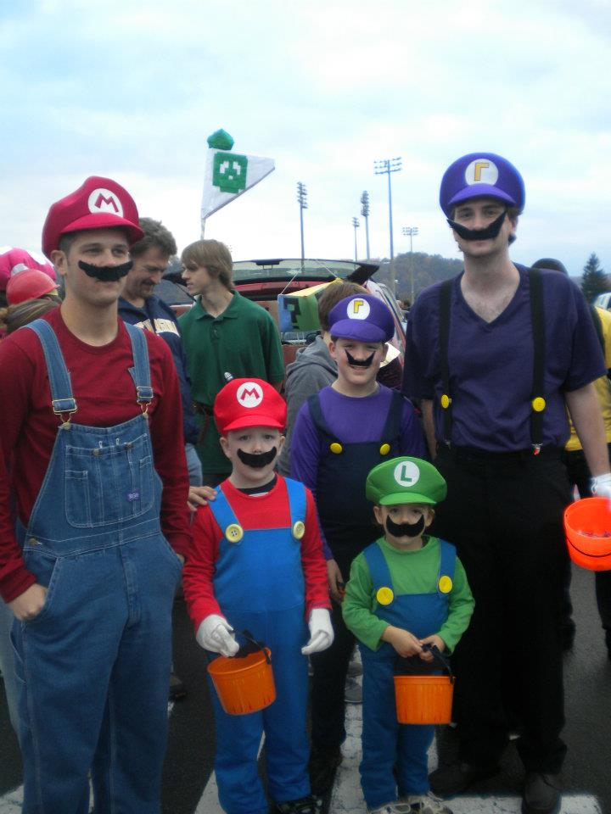
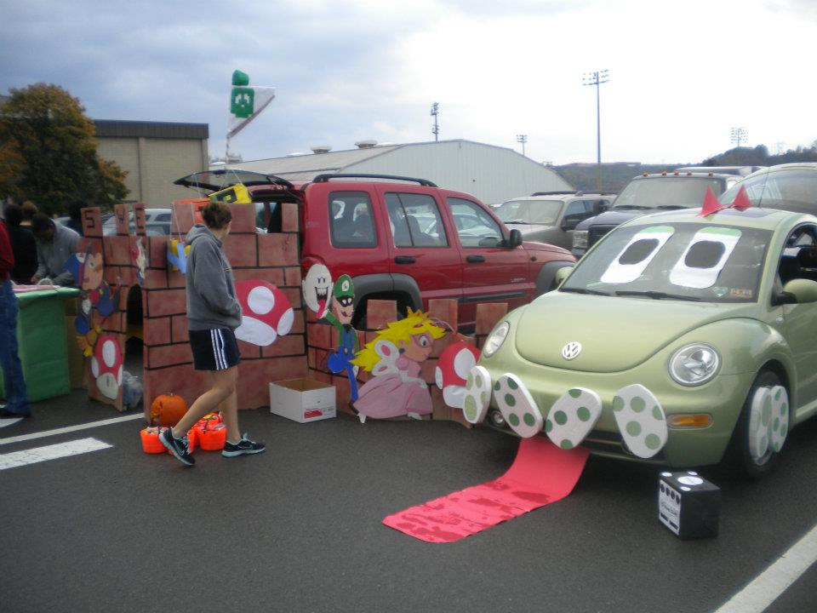
Trunk-or-Treat Date: Saturday, October 31st, 2015 (tentative)
The Institute of Industrial Engineers will be hosting Trunk or Treat in the concourse level of the Coliseum this year. This is an annual community event where local families bring their children to trick or treat at various student organizations’ tables. Groups that participate in this event are encouraged to dress up in (kid-appropriate) Halloween costumes and to decorate their tables. Groups are responsible for purchasing their own candy—plan for approximately 1000 kids.
Theme: ???
Lead: Alex Anderson, Anna Gilpin

Slide 7
More Fall Semester Events
ASME Pumpkin Drop (October 23)
The American Society of Mechanical Engineers along with the MAE Department will host the pumpkin drop. Volunteers will be needed to help run various aspects of the event. The event will run from 8 a.m. until 3 p.m.
ASCE Run For Your Life 5K
October 24th at Rec Center
Starts at 9 AM
Contact rlbutler@mix.wvu.edu with questions
WVU Open House (October 17)
WVU Open House (October 24)
High School Visitation Day (October 31st)
Volunteers will be needed for both open houses (I think?)
More info to come when it become available

Slide 8
More Fall Semester Events
Girls Rock Science
Outreach event at the Carnegie Science Center on October 4th
Need 2-3 Volunteers to work a SWE booth with the Pittsburgh area sections.
Available times are 10:30-12:30 and 12:00-2:30
Email the WVU SWE account if you are interested

Slide 9
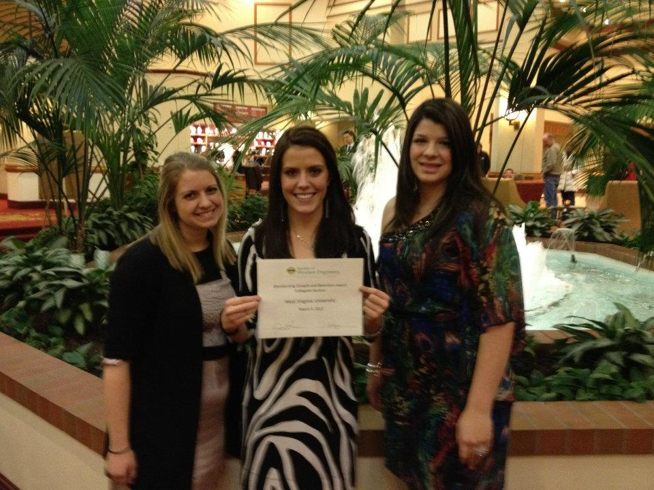
Spring Events
Engineering Formal
8th Grade Day
Girl Scout Day

Slide 10
Professional Development
Companies LOVE SWE!
Networking events
Info sessions
Professional development events
Visiting Companies:
Delloitte
NASA
Others?

Slide 11
Mentoring
Freshmen will be paired with upperclassmen based on major and interests
Mentors and mentees will meet about once a month
We will have a couple mentoring events throughout the school year

Slide 12
Join Societal SWE!
Membership Type | Cost | Description
Collegiate | $20 per year | Membership to Societal SWE for one year only
Collegiate to Career (C2C) | $50 | Membership to Societal SWE for all collegiate years (incl. grad school) plus first year as a professional
Joint Membership | 30% DISCOUNT | Save 30% for joining American Indian Science & Engineering Society (AISES), National Society of Black Engineers (NSBE), or Society of Hispanic Professional Engineers (SHPE) versus joining separately
Country of Residence Discount | 33% or 66% DISCOUNT | If you are not from the US, you may be eligible for a 33% or 66% discount!

Slide 13
Join Societal SWE!
Though you are more than welcome to join WVU SWE and attend our events…
IF YOU ARE NOT A PAID MEMBER, YOU ARE NOT A SWE MEMBER, AND YOU CANNOT PUT IT ON YOUR RESUME!
If you need financial assistance, let us know!!!
http://societyofwomenengineers.swe.org/index.php/membership
If you need help registering, let us know!!!

Slide 14
Contact Information
E-mail:
wvuswe@gmail.com
Facebook:
www.facebook.com/WVU_SWE
Twitter:
@WVU_SWE
Website:
http://swe.studentorgs.wvu.edu/
Region Blog:
http://region.wordpress.com/

