Slide 1
Society of Women Engineers West Virginia University Section 3rd General Meeting
Tuesday November 3rd, 2015

Slide 2
Agenda
Trunk-or-Treat
Annual Conference
SWEsters Scavenger Hunt
SWE Luncheon
Operation Christmas Child
Region Conference
Bubble Soccer
Spring Semester Events

Slide 3
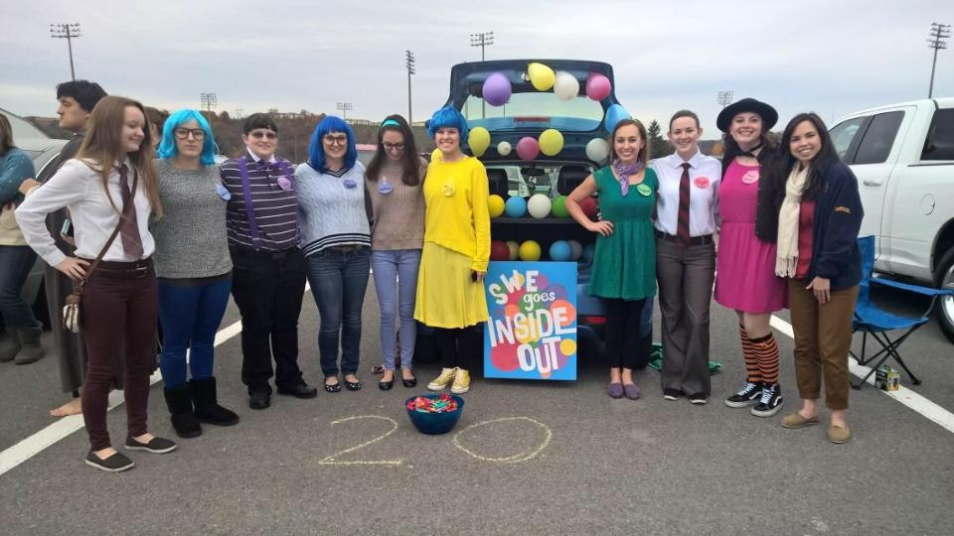
Trunk-or-Treat Date: Saturday, October 31st, 2015
Theme: Inside Out
Lead: Alex Anderson, Anna Gilpin

Slide 4
Annual Conference
Annual Conference was October 22-24 in Nashville
WVU SWE won Silver Level Outstanding Collegiate Section
Sabrina Ridenour was runner-up in the Sing it to Begin It Competition
Region G was runner up in the Subject Matter Expert Bowl

Slide 5
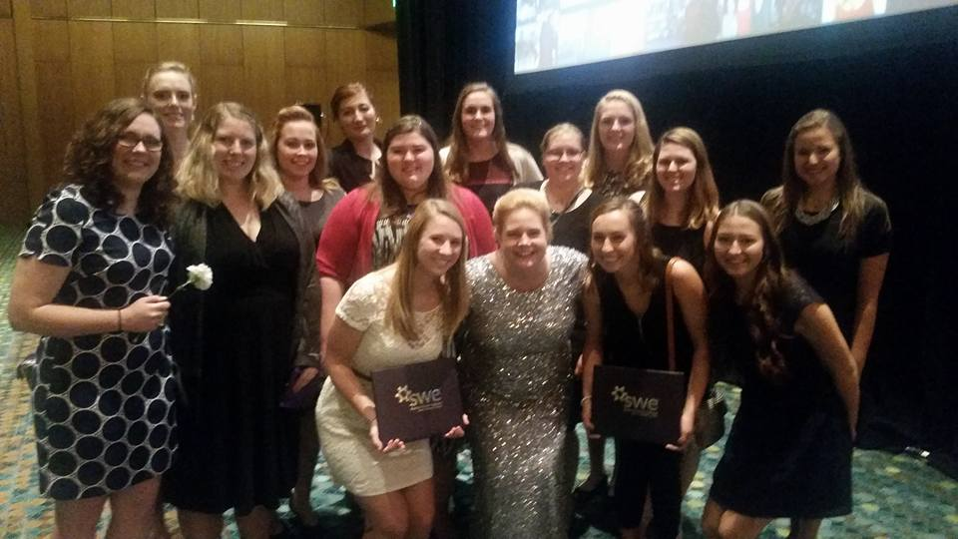
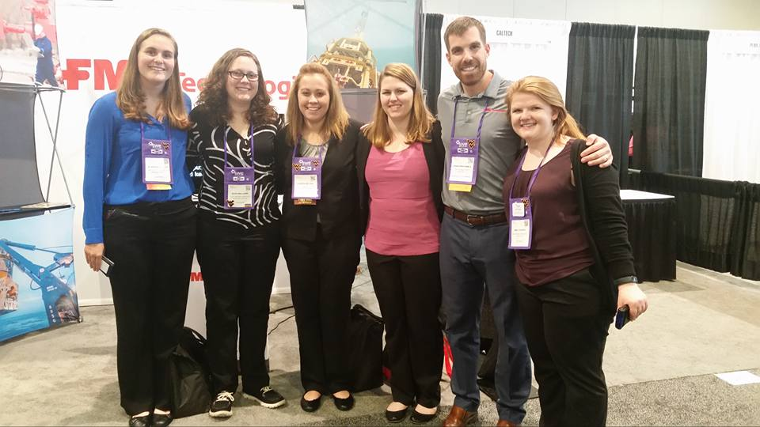
Annual Conference

Slide 6
SWEsters Scavenger Hunt!!
This Friday, November 6
Meet in the freshman atrium at 5:30 pm
Dinner at Blackbear afterwards
If you are interested in joining SWEsters, please come to the scavenger hunt!
Contact Julie Peng for questions at jepeng@mix.wvu.edu or 304-634-5502

Slide 7
Luncheon with Carol Battershell November 11, 12PM
SWE is hosting a lunch with Carol Battershell November 11 at 12PM in AERB (new engineering building) in room 120.
We have room for 20 people to attend

Slide 8
Operation Christmas Child
We will be packing shoeboxes for Operation Christmas Child the week before Thanksgiving Break

Slide 9
Region Conference
The 2016 Region G Conference will be at the University of Cincinnati February 4-6
We can take as many people as interested
A Google form will be sent out with the slides after the meeting for those interested in attending

Slide 10
Bubble Soccer Tournament
SWE is looking to form a team for Tau Beta Pi’s bubble soccer tournament on November 8th from 3-6PM
Teams are 5 on 5
Email the SWE account if interested

Slide 11
Spring Events
Regional Conference
February 4-6 at University of Cinncinnati
Engineering Formal
Date TBA
8th Grade Day
February 13th
Girl Scout Day
April 9th

Slide 12
Contact Information
E-mail:
wvuswe@gmail.com
Facebook:
www.facebook.com/WVU_SWE
Twitter:
@WVU_SWE
Website:
http://swe.studentorgs.wvu.edu/
Region Blog:
http://region.wordpress.com/

