Slide 1
Society of Women Engineers West Virginia University Section 2nd General Meeting
WEDNEsday, October 14th, 2015

Slide 2
Agenda
Trunk-or-Treat
Fall Semester Events
SWE Movie Night
SWE Luncheon
Spring Semester Events

Slide 3
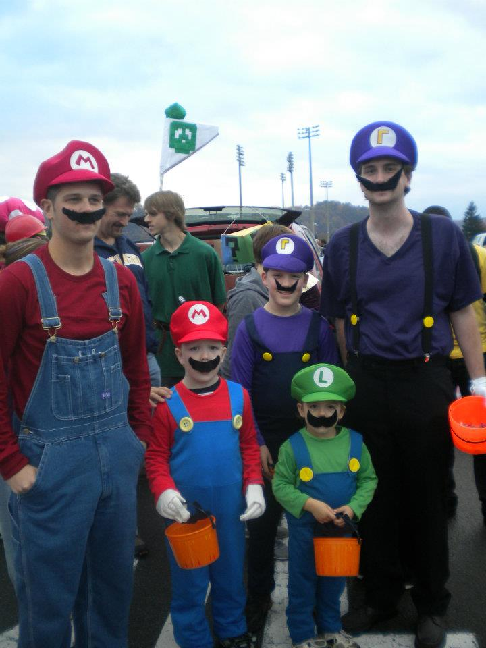
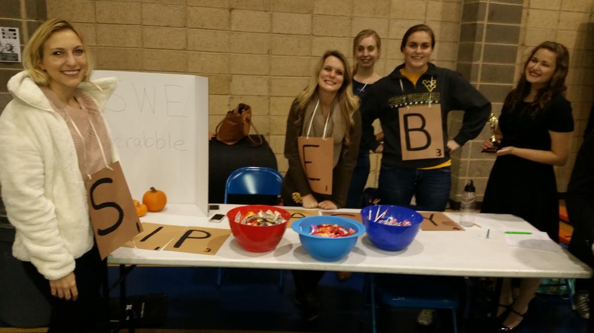
Trunk-or-Treat Date: Saturday, October 31st, 2015
The Institute of Industrial Engineers will be hosting Trunk or Treat in the concourse level of the Coliseum this year. This is an annual community event where local families bring their children to trick or treat at various student organizations’ tables. Groups that participate in this event are encouraged to dress up in (kid-appropriate) Halloween costumes and to decorate their tables. Groups are responsible for purchasing their own candy—plan for approximately 1000 kids.
Theme: Inside Out
Lead: Alex Anderson, Anna Gilpin

Slide 4
More Fall Semester Events
ASME Pumpkin Drop (October 23)
The American Society of Mechanical Engineers along with the MAE Department will host the pumpkin drop. Volunteers will be needed to help run various aspects of the event. The event will run from 8 a.m. until 3 p.m.
ASCE Run For Your Life 5k (October 24)
If you like running, support ASCE
Registration is $5
The race starts at the rec center at 9AM
WVU Open House (October 17)
WVU Open House (October 24)
Volunteers will be needed for both open houses from 9-12

Slide 5
More Fall Semester Events
High School Visitation Day (October 31st)
This College sponsored event is a day where high school students are invited to come to the College and meet current students and faculty, while learning more about two departments of their choice
Lots of volunteers needed
Operation Christmas Child (November)
Lead: Hannah Bartlett
This is a SWE sponsored event that takes place around the end of the fall semester making gift boxes to send to countries in need.

Slide 6
FIRST Lego League Tournament Date: November 14th, 2015
Robotics competition for children at Jackson’s Mill (Weston, WV)
Volunteers needed as judges, referees, and miscellaneous help throughout the day
Prior robotics experience is not required
Email the SWE account if you are interested

Slide 7
SWE Movie Night!
SWE trip to the movies to watch the Martian Friday, October 16th
Meet at the Freshman atrium (outside the ELC) at 7:00 to carpool
Movie time is 7:30 at Carmike Cinemas (Morgantown Mall)

Slide 8
Luncheon with Carol Battershell November 11, 12PM
SWE is hosting a lunch with Carol Battershell November 11 at 12PM in AERB (new engineering building) in room 120.
We have room for 30 people to attend

Slide 9
Carol Battershell Deputy Director of Energy Policy and Systems Analysis
Carol joined the Department of Energy, Energy Efficiency and Renewable Energy (EERE) after 25 years in the energy industry with Standard Oil and BP. In 2008 and 2009 she led the technical evaluation for the $25 billion Advanced Technology Vehicle Manufacturing Program as well as the $2.3 billion Advanced Energy Manufacturing Tax Credit initiative. In 2010 she took over management of EERE field operations, including direct leadership of the Golden, Colorado office which provides service for all of EERE. This office typically is responsible for about $1billion of clean energy grants and research projects and during the Recovery Act managed $7 billion of grants, research and construction. In 2013 she joined the new DOE office of Energy Policy and Systems Analysis where she was a key contributor on the multi-Agency Quadrennial Energy Review.
Her last roles at BP included:
· Vice President, Policy and Strategy for BP Alternative Energy where she was instrumental in developing the strategy and business case for an $8 billion investment to launch and grow the new BP Alternative Energy division, and
· Vice President, Renewables and Alternative Fuels where she directed BP's global activities in hydrogen research and wind power, as well as managed BP's "green energy" marketing and consulting company.
Additional energy industry positions have included operations and strategy roles in retail fuels marketing, strategy and financial roles in business-to-business fuels marketing, as well a corporate role in environmental policy and a development role as chief of staff to one of BP's most senior executives. She began her career as a refinery engineer in Ohio.
Carol has a BS in engineering from Purdue University where she specialized in environmental engineering and an MBA from Case Western Reserve University.
She has worked in a variety of locations in the United States, and has spent ten years living and working in Europe.

Slide 10
Spring Events
Regional Conference
February 4-6 at University of Cinncinnati
Engineering Formal
Date TBD
8th Grade Day
February 13th
Girl Scout Day
April 9th

Slide 11
Contact Information
E-mail:
wvuswe@gmail.com
Facebook:
www.facebook.com/WVU_SWE
Twitter:
@WVU_SWE
Website:
http://swe.studentorgs.wvu.edu/
Region Blog:
http://region.wordpress.com/

