Slide 1
Society of Women Engineers West Virginia University Section
January General Meeting
1/26/2016

Slide 2
Agenda
SWE Polos
Girl Scout Day
Women’s Basketball game Social 1/30
8th Grade Day 2/13
Women’s Empowerment Night 2/12
Reverse Career Fair 2/17
Continental Tire Luncheon 2/22
Engineering Formal 2/27
Policy 49 training
Professional Development
New Website

Slide 3
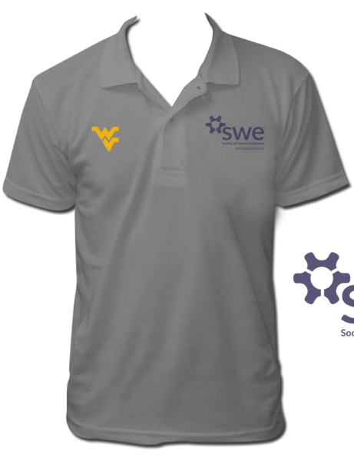
SWE Polos
We are currently taking preorders for SWE polos
Polos will be $27
Chest Decal

Slide 4
Girl Scout Day
Girl Scout Day will be April 9th
The planning committee is looking for members to serve on the planning committee
Contact Taylor Davis and Sabrina Ridenour
tmdavis@mix.wvu.edu and seridenour@mix.wvu.edu

Slide 5
Women’s Basketball vs Baylor 1/30
Meet us at the Evansdale Crossing at 5:30 to eat dinner
We will walk to the Coliseum to watch the women’s basketball team play Baylor at 7PM
Email wvuswe@gmail.com if you need transportation

Slide 6
8th Grade Day 2/13
Students from around the state come and do activities made by various student organizations in the Statler College
We will need volunteers from 8-3PM during the event

Slide 7
Women’s Empowerment Night 2/12
Volunteers are needed from 6-8PM to help run a booth at the activities fair during the event
SWE has a matching game with women scientists

Slide 8
Reverse Career Fair 2/17
Prospective employers will line up to meet us at the Reverse Career Fair
The reverse career fair will be 2/17 in the Vandalia Lounge in the Mountainlair from 3:30-5:30 PM
SWE will have a booth
You must be dressed in business attire!

Slide 9
Continental Tire Luncheon 2/22
SWE is hosting a luncheon with Kim Simpson of Continental Tire in AERB 120 starting at 11:45
Kim will be speaking and a discussion will follow
RSVP to attend

Slide 10
Engineering Formal 2/27
The event will be from 8-11PM at Bent Willey’s
We will need volunteers to sell tickets on the ground floor of ESB from 10-3 for two weeks before the event
We will also need volunteers to sell tickets at the door

Slide 11
Policy 49 Training
This is a youth protection training
Read through the workbook at http://employementservices.hr.wvu.edu/r/download/191248
Complete the open book quiz: https://www.classmarker.com/online-test/start/?quiz=jtf5399be221ab6d
Forward your certificate to cate.schlobohm@mail.wvu.edu

Slide 12
Professional Development
Mock Interview Week: January 25-28, 2016- Locations at Career Services Center, (Mountainlair), B&E Center for Career Development, Engineering Sciences Building, and Percival Hall. Sign ups still available on Mountaineer Trak.
Spring Statler college Engineering career fair series starts tomorrow from 10-2

Slide 13
New Website
Swe.orgs.wvu.edu

Slide 14
Contact Information
Email: wvuswe@gmail.com
Website: swe.orgs.wvu.edu
Twitter: @WVU_SWE
LinkedIn: WVU SWE
Facebook: facebook.com/WVUSWE
Region G Blog: https://regiong.wordpress.com/

