Slide 1
Society of
Women Engineers
West Virginia University Section
February General Meeting
2/11/2016

Slide 2
Agenda
8th Grade Day
Women’s Empowerment Night
SWE Polos
Reverse Career Fair
Continental Tire Lunch
Engineering Formal
Membership Points System
Dancing with the Mountaineer Stars
WOW Factory Social
Relay For Life
SWEFL
Discount Cards

Slide 3
8th Grade Day (February 13th)
8th Grade Day will be this Saturday
Volunteers will be needed from 8-3
In the event Monongalia County Schools are canceled Friday, this event will be moved to March 12th

Slide 4
Women’s Empowerment Night
SWE will have a booth at AAUW’s 2nd annual Women’s Empowerment Night
SWE will have a booth during the activity fair 6-8
We need volunteers to help run the booth

Slide 5
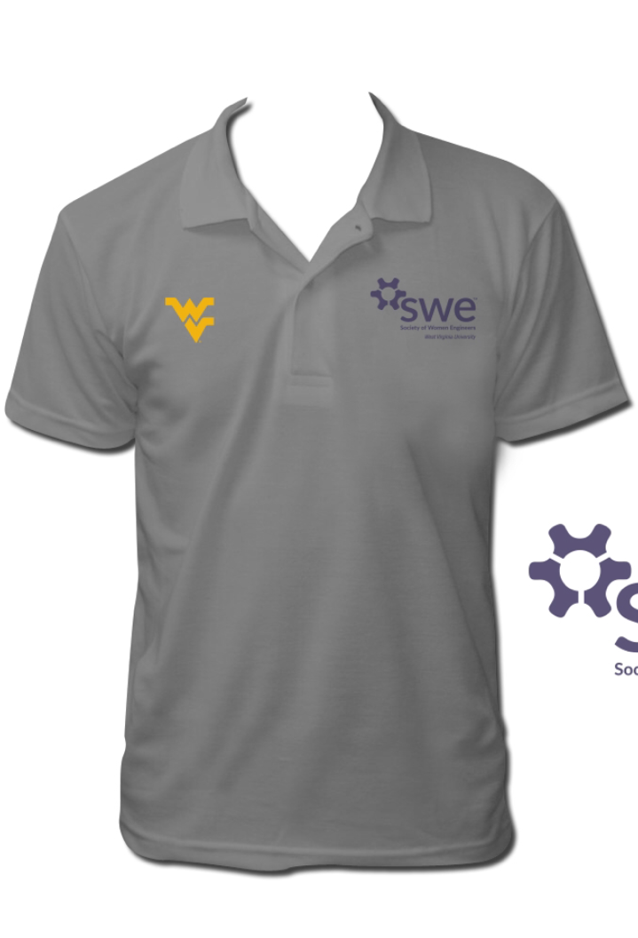
SWE Polos
Polos are $27

Slide 6
Engineering Formal
Engineering Formal will be Saturday February 27th from 8-11 at Bent Willey’s
Volunteers are needed to sell tickets on the ground floor of ESB in front of G39 and at the door on the day of the event

Slide 7
Reverse Career Fair
Employers attending the WVU career fair will line up to meet us on February 17th
The event is 3:30-5:30 in the Mountain Lair
Professional dress required (slacks and a blouse)
Email wvuswe@gmail.com if you can come so we can get a headcount

Slide 8
Membership Points System
We are starting to track what members come to SWE events
We have a spreadsheet of all societal members
New members are added at the beginning of each month
Most active member will receive a $50 gift card at the end of the year

Slide 9
Membership Points System Breakdown
SWE Meetings (1 point)
Social Events (2 points)
SWE events (3 points/hour)
Engineering Formal Ticket sales (1 point/hour)
Events requiring travel (5 points)
Luncheons (5 points)
Statler college events (2 points/hour)
Prospective student cards (1 point/5 cards)
Intramurals (5 points)

Slide 10
Dancing with our Mountaineer Stars
Donate blood on March 1st from 1-7PM in the Mountain Lair Ballrooms to support Ali Anderson!
The dancing competition will take place Saturday March 5th, 2016 at 7:30 PM in the Ballrooms

Slide 11
WOW Factory Social
We are gauging interest in a potential social at the WOW factory on a Friday evening
We would be painting pottery

Slide 12
Relay For Life
We are gauging interest in a SWE team for Relay for Life
WVU’s Relay for Life will be Friday April 22nd
Questions should be directed to Eilish Miller (ekmiller@mix.wvu.edu)

Slide 13
SWEFL
SWEFL stands for SWE Future Leader
SWEFLs are provided with leadership training and professional development
You must have at least 2 years left in a collegiate program in order to be eligible
We have had two former SWEFLs in our section, Taylor Davis and Emily Phipps

Slide 14
Discount Cards
SWE will be doing a discount card fundraiser
We are in the process of approaching businesses in the Morgantown area
We need volunteers to help our leads, Emily and Meg

Slide 15
Other Events
ASCE Blood Drive (2/24)
TEAMS (2/20)
Merit Badge University (2/27)
High School Visitation Day (3/5)
WVU Open House (3/12)
Next SWE Meeting (3/1)
Girl Scout Day (4/9)

Slide 16
Contact Information
E-mail:
  wvuswe@gmail.com
Facebook:
  www.facebook.com/WVU_SWE
Twitter:
  @WVU_SWE
Website:
  http://swe.studentorgs.wvu.edu/
Region Blog:
  http://region.wordpress.com/

